Slide 1




Computer Fundamentals & Office Applications
Submitted by:
Tayabur Rahaman
Department of Economics
University of Barishal

Slide 2
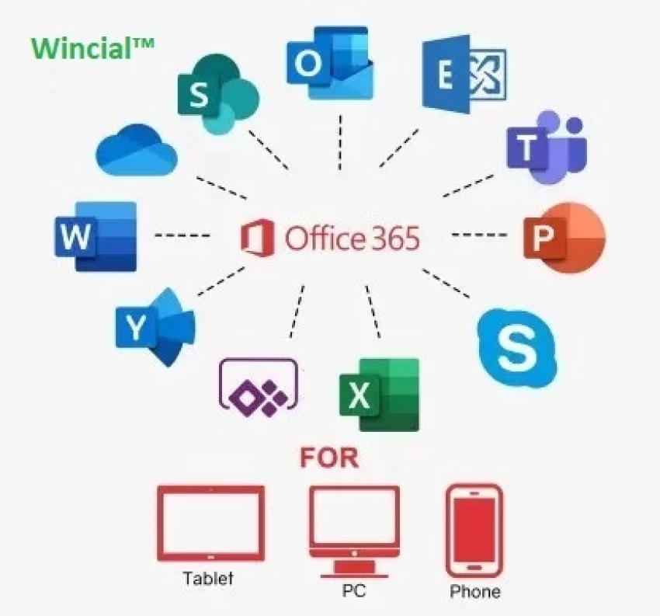
Course Contents:
Basic components of Computer
Microsoft Office Applications:
Microsoft Word
Microsoft Excel
Microsoft Powerpoint

Slide 3
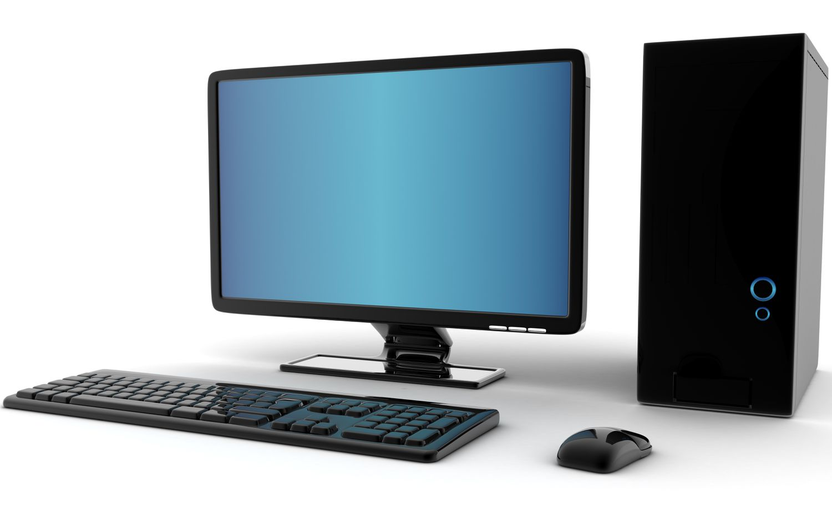
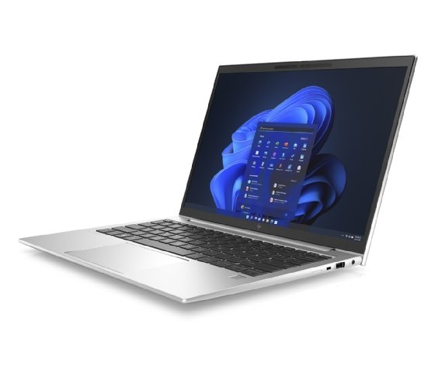
What is Computer?
A computer is a machine that can be programmed to automatically carry out sequences of arithmetic or logical operations (computation).

Slide 4
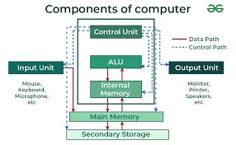
Basic components of Computer

Slide 5
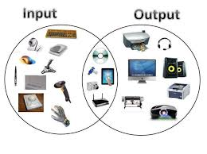
Input & Output Devices

Slide 6
Name of Input and Output Devices
Input | Output
Graphics Tablets | LCD Projection Panels
Video Capture Hardware | Monitor (LED, LCD, CRT etc)
Trackballs | Printers (all types)
Digital camera | Projector

Slide 7

What is ms word?
Used to make professional-quality documents, letters, reports, etc., MS Word is a word processor developed by Microsoft. It has advanced features which allow you to format and edit your files and documents in the best possible way.

Slide 8
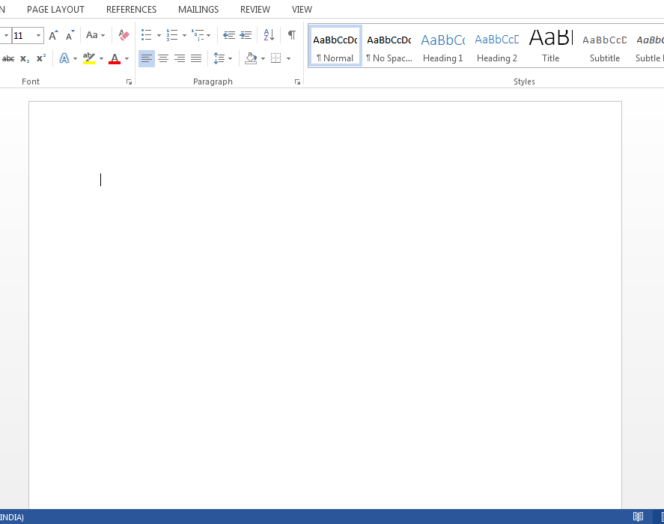
How to create an MS Word document?
To create an MS Word doc, follow the steps mentioned above to open Microsoft Word. Then once the program is open, click on “File” followed by “New”. This opens a new doc where something new can be created.
Since it is used by people of all age groups, in schools, in colleges and for official purposes, having proper knowledge of Microsoft Word is a must. The preview of the MS Doc file once it is opened is given below:

Slide 9
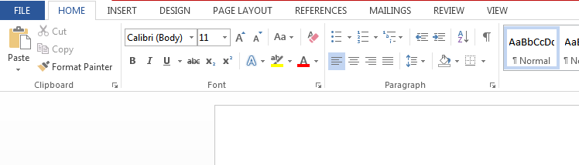
Features of MS Word:
Home
Insert
Design
Page Layout
References
Review
View
The image given below shows the different elements and categories which are
available in MS Word doc:
The basic functions of MS Word:
Creating text documents
Editing and Formatting the existing documents
Editing and Formatting the existing documents
Graphical documents, comprising images
Used by Authors and Researchers
Detect grammatical errors in a text document

Slide 10
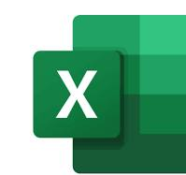
Ms Excel:
Uses of ms excel:
collection and verification of business data;
business analysis;
data entry and storage;
data analysis;
performance reporting;
strategic analysis;
accounting and budgeting;
administrative and managerial management;
account management
office administration.
MS Excel is a commonly used Microsoft Office application. It is a spreadsheet program which is used to save and analyse numerical data.

Slide 11
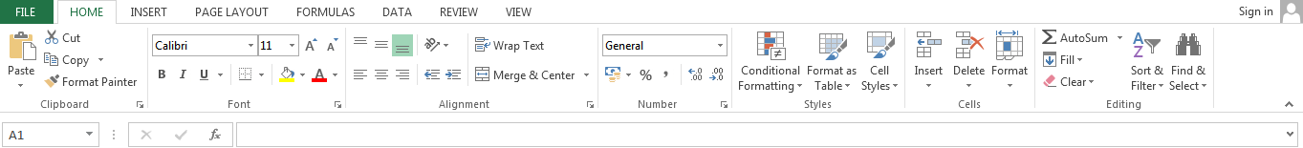
Features of MS Excel:
Various editing and formatting can be done on an Excel spreadsheet. Discussed below are the various features of MS Excel.
Home
Insert
Page Layout
Formulas
Data
Review
View
The image below shows the composition of features in MS Excel:
Basic Formulas:
Addition
Subtraction
Average
Maximum and Minimum
Concatenate
Count

Slide 12

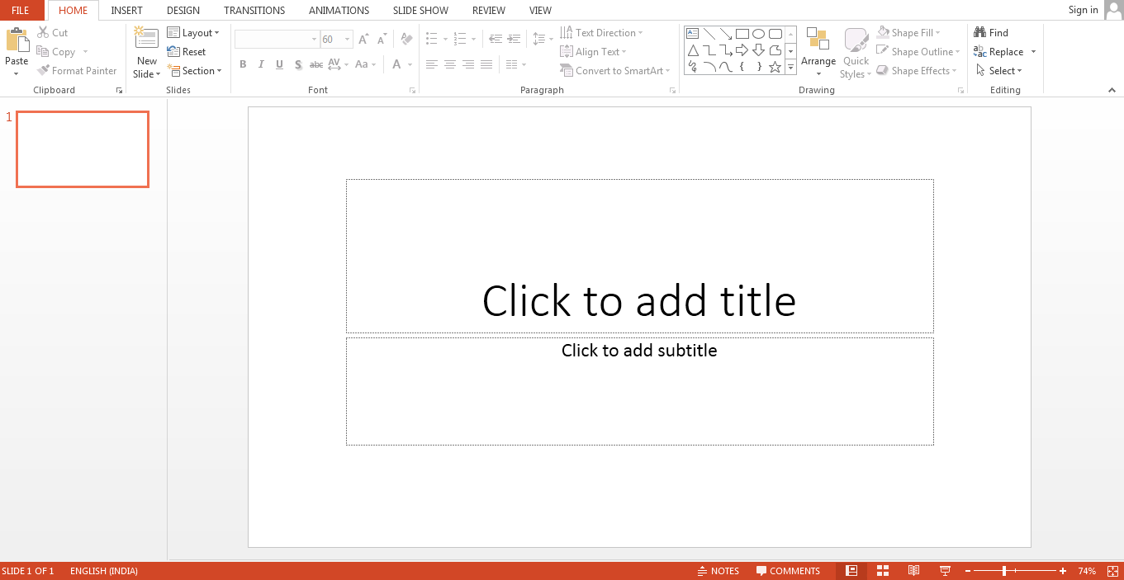
MS PowerPoint
Uses of ms powerpoint:
Create presentations from scratch or a template.
Add text, images, art, and videos.
Select a professional design with PowerPoint Designer.
Add transitions, animations, and cinematic motion.
Save to OneDrive, to get to your presentations from your computer, tablet, or phone.
Share your work and work with others, wherever they are.
PowerPoint (PPT) is a powerful, easy-to-use presentation graphics software program that allows you to create professional-looking electronic slide shows.
The image given below shows the main page of MS PowerPoint, where a person lands when the program is opened on a computer system:

Slide 13


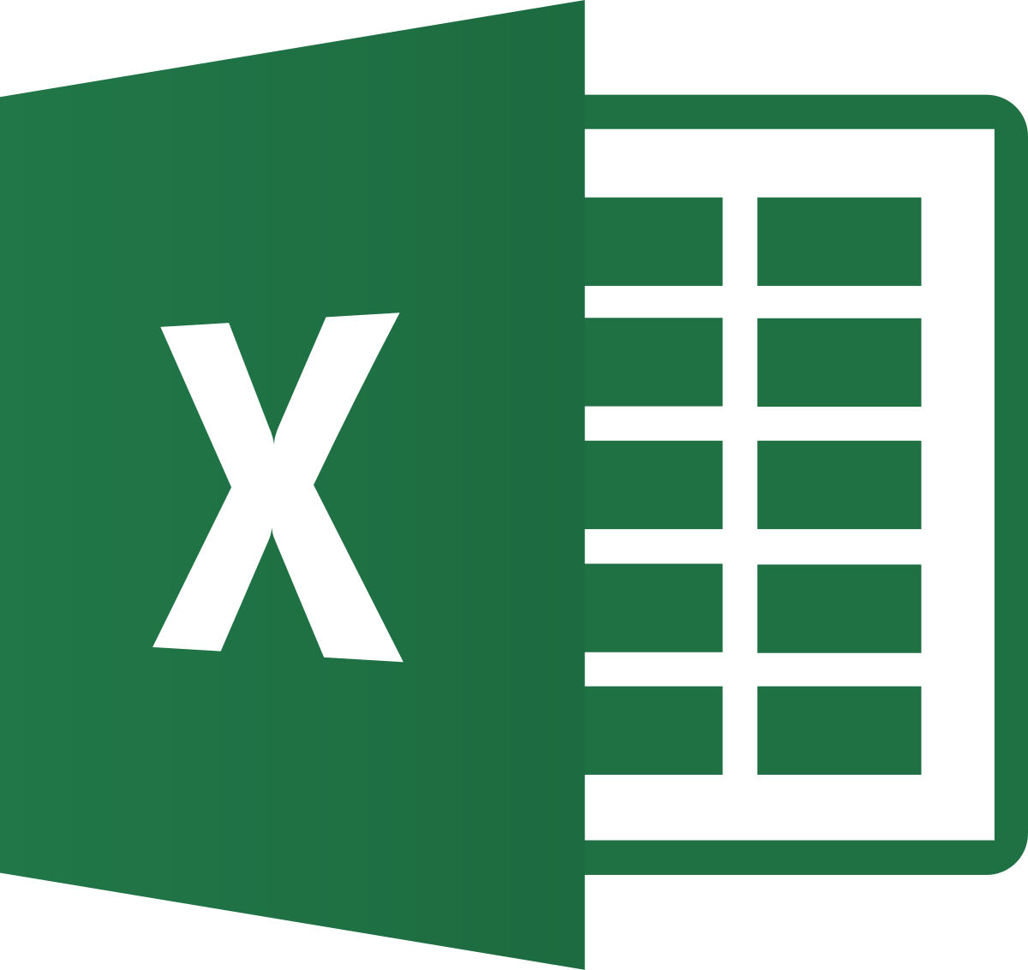
Animations:
The different animation styles available on PowerPoint are:

Slide 14
Computer user %
country | Bangladesh | India | Nepal | Pakistan | Mayanmr
User % | 76 | 83 | 66 | 75 | 60

Slide 15

Thank You

